Slide 1
Sharpen the Focus:
Target Marketing Strategies and Customer Relationship Management
Chapter Six

Slide 2
Chapter Objectives
Identify the steps in the target marketing process
Understand the need for market segmentation and the approaches available to do it
Explain how marketers evaluate segments and choose a targeting strategy
Understand how marketers develop and implement a positioning strategy
Explain how marketers increase long-term success and profits by practicing customer relationship management
6-<number>
Notes:
p. 176
LECTURE NOTES:
By the end of this chapter, students should be able to:
Identify the steps in the target marketing process
Understand the need for market segmentation and the approaches available to do it
Explain how marketers evaluate segments and choose a targeting strategy
Understand how marketers develop and implement a positioning strategy
Explain how marketers increase long-term success and profits by practicing customer relationship management

Slide 3
I. Identify the steps in the target marketing process
6-<number>
Notes:
This slide relates to Learning Objective (hereafter LO) #1 of chapter 6.

Slide 4
Target Marketing Strategy: Process Overview
A condition of market fragmentation
    People’s diverse interests and backgrounds divide them into numerous groups with distinct needs and wants
Marketers select a target marketing strategy
    Marketers divide the total market into different segments, select one or more segments, and develop products to meet the needs of those specific segments
6-<number>
Notes:
This slide relates to LO #1 of chapter 6.
p.176
LECTURE NOTES:
The marketing concept dictates that firms should make every effort to understand and satisfy customer needs. Unfortunately, understanding needs is an increasingly complex task because of market fragmentation. Technological and cultural changes in our society have increased the diversity of people’s interests and backgrounds, leading to the creation of many consumer groups, each with its own set of needs.
As a result of market fragmentation, marketers follow a target marketing strategy.

Slide 5
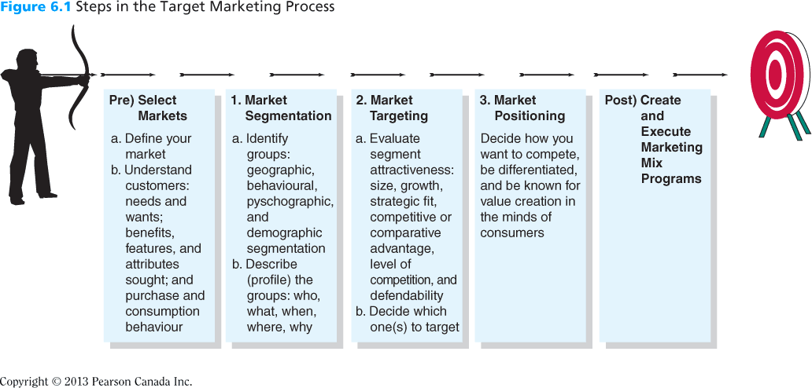
Figure 6.1
Steps in the Target Marketing Process
6-<number>
Notes:
This slide relates to LO #1 of chapter 6.
p.177
LECTURE NOTES:
Market fragmentation, and the reduced effectiveness of mass marketing efforts in turn underscores the importance of developing a true target marketing strategy.
The target marketing strategy process consists of five separate yet interrelated steps shown in Figure 6.1.

Slide 6
Criteria for Identifying Market Segments
A viable segmentation approach should satisfy the following requirements
    Consumers must be similar enough within the segment
    Consumers must be different enough between the segments
    The segment must be large enough
    The segment must represent a measureable market
    The segment must be reachable
6-<number>
Notes:
This slide relates to LO #1 of chapter 6.
p.177 - 178

Slide 7
II. Understand the need for market segmentation and the approaches available to do it
6-<number>
Notes:
This slide relates to LO #2 of chapter 6.

Slide 8
Step 1: Segmentation
Segmentation is the cornerstone of marketing strategy
    Segmentation: The process of dividing a larger market into smaller pieces based on one or more meaningfully shared characteristics
Three key segmentation variables are
    Behaviour
    Psychographics
    Demographics
6-<number>
Notes:
This slide relates to LO #2 of chapter 6.
p.178 - 179

Slide 9
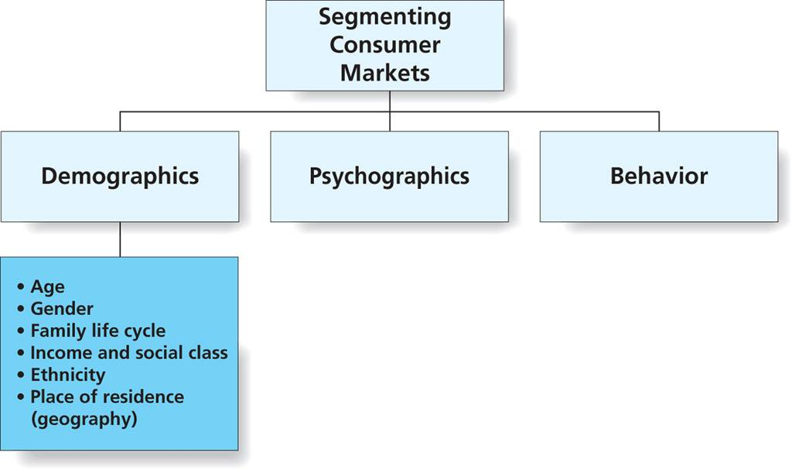
Figure 6.3
Segmenting Consumers Markets
6-<number>
Notes:
This slide relates to LO #2 of chapter 6.
p.180
LECTURE NOTES:
Segmentation is word used to describe the process of dividing a larger market into smaller pieces based on one or more meaningful shared characteristics.
In addition to needs, marketer’s use one or more segmentation variables to segment consumer markets. Segmentation variables can be defined as dimensions that divide the total market into fairly homogeneous groups, each with different needs and preferences.
Segmentation variables can be broadly classified as demographic, psychographic, or behavioral in nature, as shown in Figure 6.3.

Slide 10
Segment by Behavior
Behavioural segmentation
  A technique that divides consumers into segments on the basis of how they act toward, feel about, or use a product
Three types of behavioural segmentation
    Benefit segmentation
    Usage segmentation
    Usage occasion segmentation
6-<number>
Notes:
This slide relates to LO #2 of chapter 6.
p.179 – 180
LECTURE NOTES:
Finally, usage occasions represent a final type of behavioral segmentation. Many products such as Christmas cards and Easter egg coloring kits are associated with holidays. Other products are associated with specific times of the day (orange juice / breakfast), business functions (party platters/catering by restaurants), or casual get togethers.
The Biltmore Estate, pictured on this slide, increased attendance during its annual Christmas celebration as part of a strategy to segment on the basis of usage occasion. As part of this strategy, heavy users (defined as families who have made the Christmas pilgrimage an annual event) received a different invitation and a customized package design to appeal to them which differed from that sent to the other three segments. By catering to the differences between these segments, visits increased by 300% in a single season.

Slide 11
Segment by Behavior (ctn’d)
Benefit segmentation
  A segmentation approach that groups consumers or customers based on the benefits or value they seek in buying and using products
  Consumers seek different types of benefits from products
    E.g., restaurants identify different consumer segments
      Convenience seekers, fun seekers, health oriented, fine-dining experiences seekers, novelty seekers, cost oriented, family oriented, image or status oriented, culture seekers
6-<number>
Notes:
This slide relates to LO #2 of chapter 6.
p. 180

Slide 12
Segment by Behavior (ctn’d)
Usage segmentation
  A segmentation approach that groups consumers or business customers based on the amount of a product purchased or consumed or how the product is used
  80/20 rule
    20% of purchasers account for about 80% of the products sales
  A new approach: long tail
    An idea that companies can make money by selling small amounts of items that only a few people want, provided they sell enough different items, e.g. Amazon, Netflix
6-<number>
Notes:
This slide relates to LO #2 of chapter 6.
p.180 – 181
LECTURE NOTES:
One way to segment on the basis of behavior is to divide the marketing into users and non-users. While this can be helpful, further segmenting the market according to usage status (heavy, medium, and light users) allows for more effective targeting, as the 80/20 rule dominates the majority of situations.
The 80/20 rule suggests the 20% of the purchasers (a small portion of the target market) account for 80% (or the majority) of the volume. This underscores the importance of targeting heavy users, as it implies that the majority of purchases are made by a minority of the consumers.
The long tail concept takes the opposite approach to segmentation. This approach is based on the idea that firms can make money by selling small amounts of items that only a few people want (e.g., targeting small volume segments), provided that they sell enough different items. Examples of firms that have embraced the long tail form of segmentation include Amazon.com (3.7 million titles, many of which will only sell a few hundred or thousand copies) and Netflix (infrequently rented older, foreign, and obscure films are kept in inventory in addition to blockbusters).

Slide 13
Segment by Behavior (ctn’d)
Usage occasions segmentation
  A segmentation approach that segmentation is based on the context in which consumers use a product most
  Certain products are strongly associated with particular occasions
    E.g., Thanksgiving and turkey, pumpkin pie, cranberry juice, Christmas cards during Christmas
    A mixed blessing for such products
      Sales are guaranteed in the occasion
      The product can be locked into an occasion
6-<number>
Notes:
This slide relates to LO #2 of chapter 6.
p.181
LECTURE NOTES:
Usage occasions represent another type of behavioral segmentation. Many products such as Christmas cards and Easter egg coloring kits are associated with holidays. Other products are associated with specific times of the day (orange juice / breakfast), business functions (party platters/catering by restaurants), or casual get togethers.

Slide 14
Segment by Psychographics
Psychographic segmentation
  A segmentation approach that groups people based on their attitudes, beliefs, values, lifestyles, or other psychological orientations
Marketers often group consumers by their psychological orientation
    E.g., Harley–Davidson’s buyers
    Those who are thrill-seekers and have an affinity for a counter cultural image
6-<number>
Notes:
This slide relates to LO #2 of chapter 6.
p.181 – 182
LECTURE NOTES:
Psychographic segmentation:
The use of psychological, sociological, and anthropological factors to construct market segments
Members of a psychographic segment typically share activities, interests, and opinions, often abbreviated as AOI. For example Harley-Davidson’s customers include thrill-seekers as well as weekend warriors who have an affinity for counterculture. Even doctors and lawyers may be members of the Harley Owners groups (HOGS). Understanding psychographics is important; while the average age of Harley riders has risen to about 46, older than the industry average of 38, Harley-Davidson knows better than to emphasis safety features or conservatism in their advertising. Thrill seekers aren’t that concerned with safety and those who enjoy a counter culture would not be receptive to ads equating Harleys with conservatism.

Slide 15
Segment by Psychographics
Harley-Davidson knows better than to emphasis safety features or conservatism in their advertising. Thrill seekers aren’t that concerned with safety

Slide 16
Segment by Psychographics (ctn’d)
Some marketers identify lifestyle segments such as
    Yuppies
    Dinks
    Shredders
    Granolas
    Metrosexuals
Marketers communicate with consumers how their brands support or are consistent with a particular lifestyle
6-<number>
Notes:
This slide relates to LO #2 of chapter 6.
p.182 – 183
LECTURE NOTES:
Psychographic segmentation:
The use of psychological, sociological, and anthropological factors to construct market segments
Members of a psychographic segment typically share activities, interests, and opinions, often abbreviated as AOI. For example Harley-Davidson’s customers include thrill-seekers as well as weekend warriors who have an affinity for counterculture. Even doctors and lawyers may be members of the Harley Owners groups (HOGS). Understanding psychographics is important; while the average age of Harley riders has risen to about 46, older than the industry average of 38, Harley-Davidson knows better than to emphasis safety features or conservatism in their advertising. Thrill seekers aren’t that concerned with safety and those who enjoy a counter culture would not be receptive to ads equating Harleys with conservatism.

Slide 17
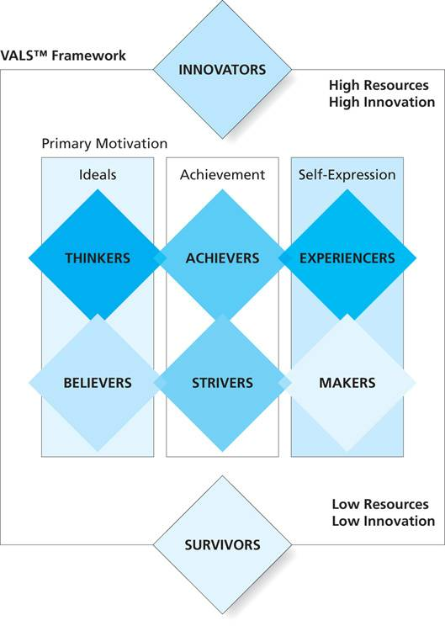
Figure 6.4
VALSTM Framework
VALS is a psychographic system that divides people into eight segments
Learn more about each segment by visiting Strategic Business Insights (VALS types)
Take the VALSTM survey by visiting Strategic Business Insights (survey link)
6-<number>
Notes:
This slide relates to LO #2 of chapter 6.
p.183 – 184
LECTURE NOTES:
The best known general psychographic segmentation system is named VALS, which stands for values and lifestyles. The VALS system segments the US consumers into eight unique groups based on 1) their primary motivation and 2) their level of resources and innovation.
Primary motivations include ideals (meaning consumers are motivated by knowledge and principles); achievement (purchases reflect status and achievement to their peers), and self-expression, (purchases reflect a desire for social/physical activity, variety, and risk.
According to the VALS website, “A person's tendency to consume goods and services extends beyond age, income, and education. Energy, self-confidence, intellectualism, novelty seeking, innovativeness, impulsiveness, leadership, and vanity play a critical role. These psychological traits in conjunction with key demographics determine an individual's resources. Various levels of resources enhance or constrain a person's expression of his or her primary motivation.” http://www.strategicbusinessinsights.com/vals/ustypes.shtml#motivation
WEBSITE NOTES:
The link shown on the left hand side of Figure 7.3 will open a web page showing an identical figure. To the right of the figure, the instructor may wish to click on each of the links shown, each of which leads to a detailed description of one of the eight VALS segments.
The link to the right of Figure 7.3 on this slide launches a gateway page from which visitors can take the VALS survey. It might be beneficial to launch the survey, for the purpose of illustrating to students the type of questions which are used to classify students.

Slide 18
Segment by Demographics
Demographics
  Variables that describe objective characteristics of a population or group
Important demographic variables include
    Sex
    Age
    Family lifecycle
    Income and social class
    Ethnicity
    Geography
6-<number>
Notes:
This slide relates to LO #2 of chapter 6.
p.184 – 191
LECTURE NOTES:
Demographics are vital for identifying the best potential customers for a product or service because objective characteristics like a person’s sex or age are usually easy to identify, and demographic information about a consumer market can be easily obtained from government sources like Statistics Canada.

Slide 19
Segment by Demographics: Sex
Marketers segment the market by male or female consumers
Many products appeal to one sex or the other, e.g.,
    Pink and blue baby products
    Razors for men or women
    Magazines for male and female
    …
6-<number>
Notes:
This slide relates to LO #2 of chapter 6.
p.185 - 186
LECTURE NOTES:
In addition to products that are only sold to one gender or another, many marketers develop parallel products which each appeal to a different sex. Pink and blue diapers, men and women’s razors, and men and women’s Nikes are just a few examples.
Until recently, purses and many types of grooming products were marketed exclusively to women. However, growing recognition of the “metrosexual” has led many marketers to target this group when selling fashion accessories, personal care items, and “man-bags”.
DISCUSSION NOTE:
ASK students to identify some products that are specifically targeted to one gender or another. Likely responses may include perfume, cologne, feminine hygiene products, clothing, shoes, wigs, etc.

Slide 20
Segmenting by Demographics: Age
Consumers in different age groups have different preferences for product categories and brands
Different consumer age groups include
    Tweens (between 9 and 12)
    Teens (between 13 and 19)
    spend nearly $3000 of their own money on cosmetics, fast foods, and other feel good products.
    Which company market to this segment most?
6-<number>
Notes:
This slide relates to LO #2 of chapter 6.
p.185 – 188
LECTURE NOTES:
Age is a popular demographic segmentation base because different age groups have different needs and wants; specifically, members of a generation tend to share the same outlook and priority. For this reason, many marketers engage in generational marketing.
When advertising to children, marketers use cartoons and shows such as Hannah Montana, American Idol, and others.
Teens: Teens are defined as people falling within the 13-19 year old age group. Marketers are particularly interested in teens because this group is growing nearly twice as fast as the general population. Furthermore, this group (as well as the “tweens”, kids 9-12 years old), spend nearly $3000 of their own money on cosmetics, fast foods, and other feel good products.
Apple has had exceptional success marketing to teens, particularly via products such as the iPod which allows teens to create their own content and control every aspect of their music consumption. Teens have a strong need for individuality, which Apple caters to. Teens don’t particularly like to be marketed to, which is a great fit for Apple’s approach of letting fans and the media do their marketing for them. The iPod and iPhone are iconic symbols of modern youth— stylish, nonconforming, and an expression of a clear difference from the past.
Generation Y is also called “Millennials” or the “Baby Boomlet” by some. This free-spending group is highly attractive, as they represent approximately 26% of the population. They are the first generation to grow up in a wired world, and are ethnically diverse. Unfortunately, Gen Y is somewhat difficult to reach because they resist reading (meaning newspapers and magazines can’t reach them easily) and don’t watch a lot of TV. When they do, they gravitate towards alternative fare such as the late-night lineup on Adult Swim. Better methods of reaching this group include social networking, email, online chat rooms, and other digital and social networking methods.
Generation X: Some members of Gen X have historically been negatively portrayed in the media as slackers, based on the fact that a small portion of this group moved back in with their parents after graduating from college, rather than getting a job and leaving the nest. The slacker subgroup within Gen X was actually relatively small, so this gross generalization is unfair. However, it is true that many Gen Xers are skeptical of marketing claims and maintain a cynical outlook towards marketing.
Over time, Gen X has changed in many ways. On a positive note, Gen Xers are highly entrepreneurial and are responsible for a great number of start-up businesses.
Gen X seems determined in many ways to do things differently – while many Gen Xers were “latch key children” growing up, meaning that they let themselves in the house after school, got their own snacks, etc., because either both parents worked or they lived in single parent homes, Gen Xers seem determined to have stable families. More than half are involved in home improvement, and homes express their individuality, rather than serve as symbols of material success.
Baby Boomers are an important market for many businesses because this group is in its prime earning years. For example, many leisure destinations rely heavily on business provided by baby boomers – not only does this group have a high disposable income, but working members of this generation typically have a lot of vacation time available, and few worries about what to do with the kids (since most have graduated college and have moved out on their own).
Baby boomers are also a fantastic market for any product or service that disguises or compensates for the fact that are aging. Cosmetics, wrinkle creams, clothing, cars, plastic surgery . . . You name it!
Older Consumers: Currently there are more than 40 million Americans ages 65 or older, and this group will only get larger as the baby boomers continue to age. Often called “mature consumers”, this group

Slide 21
Segmenting by Demographics: Age-cont.
    Generation Y (born in 1980-1995)
    called “Millennials” or the “Baby Boomlet, the first generation to grow up in a wired world, and are ethnically diverse
    Gen Y is difficult to reach because they resist reading newspapers and magazines and don’t watch a lot of TV
    What is the best medium to reach this segment ?

Slide 22
Segmenting by Demographics: Age-cont.
    Generation Xers (born in1967-1979)
    Gen Xers are highly entrepreneurial and are responsible for a great number of start-up businesses
    Gen Xers seem determined to have stable families
    Baby Boomers (born in 1947-1966)
    an important market for many businesses because this group is in its prime earning years
    have a high disposable income, lot of vacation time available

Slide 23
Segmenting by Demographics: Age-cont.
Boomers are fantastic market for any product or service that disguises or compensates for the fact that they are aging e.g. Cosmetics, wrinkle creams, clothing, cars, plastic surgery
Older consumers (born before 1947)

Slide 24
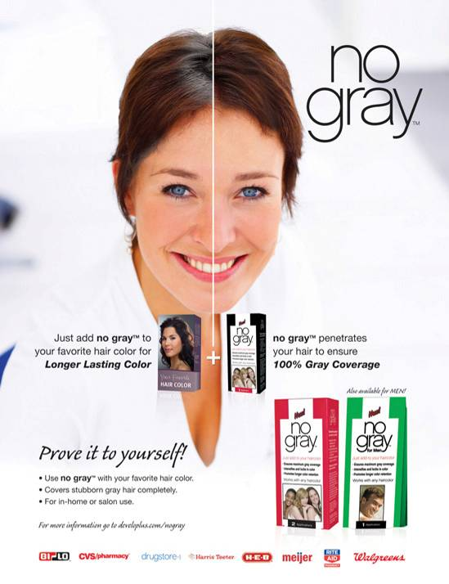

Segment by Demographics: Age (ctn’d)
Many products are designed to appeal to consumers of a specific age group.
Ford Fiesta Movement
Visit Nintendo
6-<number>
Notes:
This slide relates to LO #2 of chapter 6.
p.185 – 188
WEB SITE NOTE:
Ford Fiesta has been targeting Gen Y since 2009 “where they live” via the Ford Fiesta Movement campaign. Generation Y “Agents” complete missions in their respective cities, as assigned by Ford, and chronicle their experiences through social networks and the web site linked above.
The goal of the campaign is to build excitement and spread the word about the Ford Fiesta to the next generation of customers – Gen Y – who as of 2010 accounted for 28% of the country’s driving population.
According to the website as of March, 2011, “For the next chapter of the Fiesta Movement – and in anticipation of Fiesta arriving in the U.S. – we’re letting its fans take a crack at the advertising. They’ll use their creativity to promote the new 2011 Fiesta. And you get to be the judge. Agents who participate will get to use a Ford Fiesta over the program period. We’ll pay for the gas. Team members will compete for prizes (of varying dollar amounts) and will have an equal chance to win a Ford Fiesta.”
Nintendo has developed a line of video games (wii and Nintendo DS formats) that are designed to appeal to people of all generations, which they have labeled “Touch Generations.” Their premise is that “gaming doesn’t have an age” and the games promoted are those which allegedly can be enjoyed by the young and old alike. It might be interesting to discuss this concept with students to get their take. Are the games promoted on the Web site likely to appeal to people of different ages, or is this simply wishful thinking on Nintendo’s part? Is the Touch Generations premise contrary to the essence of segmentation and targeting?

Slide 25
It’s Debatable
Class Discussion Question
As the baby boomers age, many marketers are going to have to decide whether or not they should adapt their products so they continue to appeal to the baby boomer segment as it grows older.
Choose a particular product or service that currently appeals to baby boomers. What types of adaptations might be necessary to make this product or service appeal to those 65 years and older?
6-<number>
Notes:
This slide relates to LO #2 of chapter 6.
DISCUSSION NOTES:
Answers will vary. Some general considerations that might be pointed out as students consider this question include:
As people age, their eye sight becomes poorer and taste buds lose their ability to distinguish subtle taste differences. Restaurants who choose to continue to target the boomers may need to redesign their menu (larger type), their lighting and decor (higher light levels, more comfortable seating, more room for wheelchairs, scooters, and/or walkers), and their cuisine (more defined flavors).
As people age, they lose mobility in their joints; arthritis becomes more common. Certainly there are implications for clothing and shoe manufacturers. Baby boomers, like many segments of the population, are fond of wearing comfortable walking shoes. Yet manipulating laces through tiny holes can be chore for people with stiff fingers. Some shoe manufacturers may choose to abandon laces in favor of Velcro. Similarly, small button holes can be difficult for more mature consumers. Larger button holes, or zippered fastenings may be more attractive to people of this age group.
As people age, health-related problems increase. Clearly the aging of the baby boomers is an opportunity for pharmaceutical marketers, as well as marketers of retirement villages, assisted living facilities, physical therapy, in-home care, physician’s services, etc.

Slide 26
Segment by Demographics:
Family Life Cycle, Income and Social Class
Family life cycle
    Family needs change over time
    Different product categories ascend or descend in importance over the life cycle
Income
    Strongly correlated with buying power
Social Class
    Consumers buy according to the image they wish to portray rather than where they fall in the framework
6-<number>
Notes:
This slide relates to LO #2 of chapter 6.
p.188 – 189
LECTURE NOTES:
Family Life Cycle: Family needs change dramatically for many products over time, creating the opportunity to segment by family life cycle.
Furniture is product category that varies with the family life cycle. Singles living away from home for the first time may purchase very small refrigerators to serve as beverage coolers in their dorm room, or inexpensive press wood furniture for an apartment. Young married couples purchase a greater number of items, but quality is likely to be relatively low because cost is a concern. As children join the family, parents purchase cribs, baby changing tables, and later on, twin beds or bunk beds. As family income rises, families may move to larger homes in more affluent neighborhoods, and purchase higher-quality furniture. After the kids have moved out of the house, couples in their prime working years may acquire a second (vacation) home, or upgrade their primary home furnishings to even higher-quality items (Ethan Allen; leather sofas, etc.).
As families age and move through the cycle, some product categories gain in importance while others decline in importance. (Singles 21+ year old would be more likely to consumer alcohol and go out to bars than would a young married couple with a newborn.)
Income: The importance of income is self-evident. The more discretionary money available, the more likely it is that certain types of products and services will be consumed. {Ask students to NAME some products that are targeted to higher-income classes.} It should be noted though that the recent economic turmoil has resulted in some important changes – many individuals who were comfortable before the financial meltdown now find that they can’t retire, while others are spending more cautiously and in some cases, “downshopping”, meaning that higher income consumers are more likely to shop at stores like K-Mart and Walmart.
On the other end of the spectrum, some businesses such as WalMart, pawn shops, and payday loan places actively target individuals at the lower end of the income spectrum.
Social Class: While historically some marketers have chosen to segment by social class (such as upper class, middle class, and lower class), fewer do so today because research has shown that consumers are more likely to buy according to the image they wish to portray rather than where they actually fall within the social class framework. Of course in doing so, many of these consumers got themselves into trouble by buying on readily available credit; it will be interesting to see whether this trend reverses itself now that lending guidelines have tightened somewhat.

Slide 27
Segment by Demographics: Ethnicity
Consumers with various ethnical backgrounds have different language, culture, and purchase preferences
The largest ethnic groups in Canada include
    British Canadians
    French Canadians
    Aboriginal Canadians
      Inuit, Metis, First Nations
    German Canadians
    Italian Canadians
    Chinese Canadians
    South Asian community
    Black community
    Jewish community
6-<number>
Notes:
This slide relates to LO #2 of chapter 6.
p.189 – 190

Slide 28
Segment by Demographics: Geography
People’s preferences for products and services often depend on which geographic location they live in
Geodemography
    A segmentation technique that combines geography with demographics
PSYTE
    A Canadian geodemographic system
    Classifies Canadian consumers into 60 clusters, based on postal code and demographic information
6-<number>
Notes:
This slide relates to LO #2 of chapter 6.
p.191
LECTURE NOTES:
Recognizing that consumer preferences often vary depending on where they live, many marketers tailor their offers to geographic areas. Census data can be helpful in learning about the demographics of different state, cities or zip codes, but most marketers prefer geodemographic segmentation systems that offer more precise methods of reaching target consumers.

Slide 29
Segment Business-to-Business Markets
Segmentation helps B2B marketers understand the needs and characteristics of potential customers
Firms can be segmented by
  Organizational behaviour
  Industrial psychographics
  Organizational demographics-size of the firm or number of employees
6-<number>
Notes:
This slide relates to LO #2 of chapter 6.
p.191 - 193
LECTURE NOTES:
Segmentation helps B2B firms understand the needs and characteristics of potential customers. The underlying logic to segmentation in the B2B market is the same as with consumers, but the variables used to form segments typically differ.
For example, firms can be segmented by behavioral characteristics such as whether a given business firm is user or nonuser of the selling firm’s product.
Firms can also be segmented by the type of industrial psychographics they have.
In addition, another way to segment the firms is by organizational demographics. Organizational demographics include the size of the firm (in sales or number of employees); number of facilities, whether they are a domestic or international firm, among others.

Slide 30
III. Explain how marketers evaluate segments and choose a targeting strategy
6-<number>
Notes:
This slide relates to LO #3 of chapter 6.

Slide 31
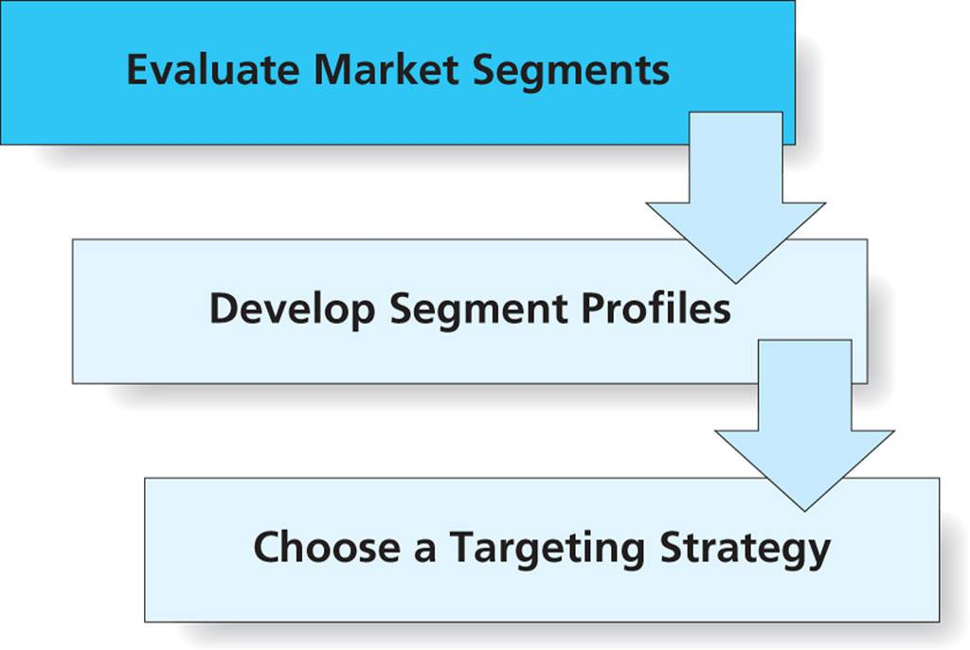
Figure 6.6
Phases of Targeting
6-<number>
Notes:
This slide relates to LO #3 of chapter 6.
p. 193
LECTURE NOTES:
Targeting is characterized by three phases in which marketers evaluate the attractiveness of each potential segment, profile each segment, and decide in which of these groups they will invest resources in order to turn them into customers.
The customer group(s) selected are referred to as the target market.

Slide 32
Evaluate Market Segments
When evaluating market segments, marketers should answer two key questions
    Is the segment actionable?
      The characteristics of the segment should be actionable so that it’s worth the effort to target the segment
    Can the marketer adequately serve the needs of the segment?
      The marketer should have the expertise and resources to satisfy the segment better than the competition
6-<number>
Notes:
This slide relates to LO #3 of chapter 6.
p. 193
LECTURE NOTES:
The first phase in targeting is to evaluate the potential of each market segments. The purpose is to weed out non-viable alternatives at the beginning of this process. To be useful, a segmentation scheme must yield at least one viable segment.
Marketer must determine if the characteristics of the segment are actionable and if it is worth the time and effort to purse the segment.
It goes without saying that the marketer must be able to satisfy the needs of the segment by means of superior resources or expertise, compared to the competition.

Slide 33
Develop Segment Profiles
After segments are identified, profiles or descriptions of the “typical” customer in a segment are developed
    Segment profiles might include demographics, location, lifestyle, and product-usage characteristics
    Cluster analysis is an analytical tool to verify profile assumptions or to scientifically identify the segments and their characteristics
    Marketers forecast each segment’s market potential
6-<number>
Notes:
This slide relates to LO #3 of chapter 6.
p. 193 – 194
LECTURE NOTES:
Segments that “pass” each step of the viability test progress to the second phase of targeting, in which segment profiles are developed. Segment profiles provide a detailed description of the typical customer in terms of key demographic, lifestyle, geographic, and product-usage behaviors.

Slide 34
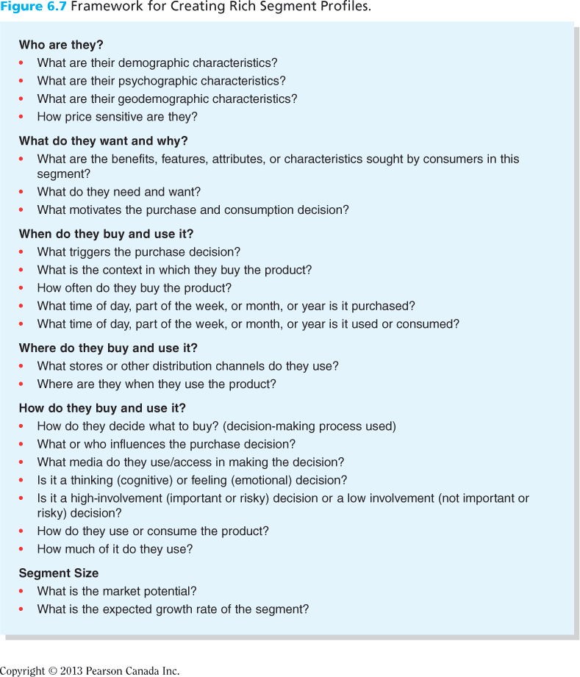
Figure 6.7
Framework for Creating Rich Segment Profiles
Figure 6.7 presents one useful template to develop segment profiles.
6-<number>
Notes:
This slide relates to LO #3 of chapter 6.
p. 195

Slide 35
Choose One or More Target Segments
Marketers evaluate the attractiveness of each potential segment and decide which one or more of these segments they will target with marketing programs
Target market
    A group that a marketing organization focuses on when developing marketing programs
6-<number>
Notes:
This slide relates to LO #3 of chapter 6.
p. 194

Slide 36
Choose a Targeting Strategy
Undifferentiated targeting strategy
    Appealing to a broad spectrum of people e.gWalmart.
Differentiated targeting strategy
    Developing one or more products for each of several distinct customer groups and making sure these offerings are kept separate in the market place
Concentrated targeting strategy
    Focusing a firm’s efforts on offering one or more products to a single segment
6-<number>
Notes:
This slide relates to LO #3 of chapter 6.
p. 196 - 197

Slide 37
Choose a Targeting Strategy (ctn’d)
Niche marketing
    A type of concentrated targeting strategy where the market segment chosen is relatively small
Custom marketing strategy
    An approach that tailors specific products and the messages about them to individual customers
    Also known as micro-marketing strategy
6-<number>
Notes:
This slide relates to LO #3 of chapter 6.
p. 197 - 199

Slide 38
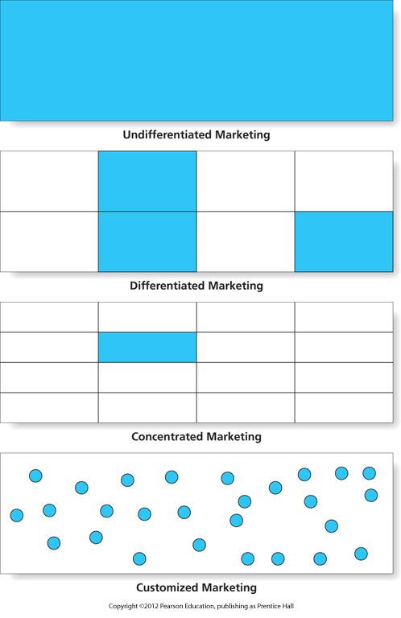
Figure 6.9
Choose a Targeting Strategy
6-<number>
Notes:
This slide relates to LO #3 of chapter 6.
p. 198
LECTURE NOTES:
The final phase in targeting is to choose a target strategy to follow. A fundamental decision must be made as to whether the firm will pursue a single large segment or focus on meeting the needs of multiple, smaller markets.
In an undifferentiated targeting strategy, the marketer assumes that people have similar needs, and an attempt is made to appeal to a broad spectrum of people. An example of a firm that follows a somewhat undifferentiated targeting strategy is Walmart. Efficiency occurs because of enhanced economies of scale. But in today’s day and age, following a purely undifferentiated strategy is risky; markets are fragmenting and for most products, needs are not similar enough to justify this technique.
Instead, the more common practice is to follow a differentiated targeting strategy in which the firm develops one or more products (and marketing strategies) for each of several customer groups. A differentiated strategy might also involve marketing a single product differently to different segments, by changing marketing communications to appeal to each targeted group.
Firms that focus their efforts on a single segment use to follow a concentrated targeting strategy. One or more products may be promoted to the segment.
Finally, a firm may choose to follow a custom marketing strategy which is explained in more detail on the following slide. : Tailoring specific products to individual customers
Common in personal and professional services, and in industrial marketing

Slide 39
IV. Understand how marketers develop and implement a positioning strategy
6-<number>
Notes:
This slide relates to LO #4 of chapter 6.

Slide 40
Step 3: Positioning
Positioning
    Developing a marketing strategy that clearly differentiates a firm’s brand from its competitors along key dimensions of value that are important to target consumers or customers
Steps in positioning
    Strategic orientation
    Differentiation
    Defendability
    Brand personality
6-<number>
Notes:
This slide relates to LO #4 of chapter 6.
p. 199

Slide 41
Strategic Orientation
Strategic orientation
    The overall approach to how you plan to compete and create value for your customers
Firms can focus on one or more of the following strategies
    Product leadership
    Customer intimacy
    Operational excellence
    Symbolic-expressive value
6-<number>
Notes:
This slide relates to LO #4 of chapter 6.
p. 199 - 201

Slide 42
Differentiation
Differentiation is to make an offer different from and better than competing offerings
Establish a brand image for one’s offer in the minds of target consumers
Use perceptual maps to understand the perceived positioning of competing brands in a market
Blue ocean strategy
6-<number>
Notes:
This slide relates to LO #4 of chapter 6.
p. 201 - 203

Slide 43
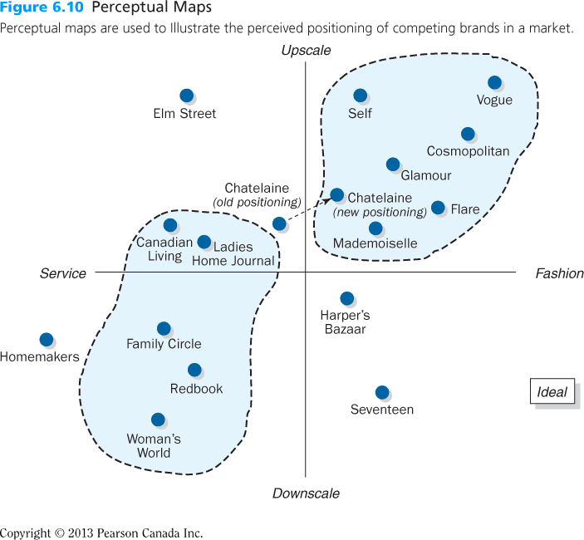
Figure 6.10
Perceptual Maps
6-<number>
Notes:
This slide relates to LO #4 of chapter 6.
p. 203
LECTURE NOTES:
Perceptual maps, such as the one shown in Figure 6.10, are often used to visually describe where products/brands are “located” in consumers’ minds relative to competing brands.
The perceptual map can sometimes help marketers understand where to position a new brand. The marketer might decide to compete directly with the upscale fashion magazines, shown in the upper right hand quadrant, or locate an underserved area, such as upscale service magazines (or downscale fashion magazines).

Slide 44
Defendability
Marketers analyze their ability to defend a particular positioning
This analysis includes assessment of
    Strengths/weaknesses of one’s firm
    One’s ability to create sustainable competitive advantage
    Opportunities/threats in external environment
      Consumers’ behaviour
      Competitors’ reaction
6-<number>
Notes:
This slide relates to LO #4 of chapter 6.
p. 203 - 204

Slide 45
Bring a Product to Life: The Brand Personality
The final element of a positioning strategy is to create a brand personality
Brand personality
    A distinctive image that captures the brand’s character and benefits
    E.g., Mac and PC are depicted to have very different brand personalities
6-<number>
Notes:
This slide relates to LO #4 of chapter 6.
p. 205
LECTURE NOTES:
Brands are often described in terms of personality traits as if they were people. People may use adjectives such as “cool” or “elegant” to describe certain brands. In fact, market research has identified five specific personality dimensions* that may be associated with brands to a greater or lesser extent.

Slide 46
BAB235 CH.6 In-class Activities
As an account executive for a marketing consulting firm, your newest client is a college—Seneca college.
You have been asked to develop a positioning strategy for the college.
Develop an outline of your ideas, including the following:
1. Who are your competitors?
2. What are the competitors’ positions?
3. What target markets are most attractive to the college?
4. How will you position the college for those segments relative to the
competition?
7-<number>

Slide 47

Bring a Product to Life: The Brand Personality (ctn’d)
Marketers take a repositioning strategy to keep up with changing times
    Repositioning involves modifying a brand image
6-<number>
Notes:
This slide relates to LO #4 of chapter 6.
p. 206

Slide 48
V. Explain how marketers increase long-term success and profits by practicing customer relationship management
6-<number>
Notes:
This slide relates to LO #5 of chapter 6.

Slide 49
Customer Relationship Management (CRM): Toward a Segment of One
Customer relationship management
  A systematic tracking of consumers’ preferences and behaviors over time in order to tailor the value proposition as closely as possible to each individual’s unique wants and needs
  CRM facilitates one-to-one marketing
6-<number>
Notes:
This slide relates to LO #5 of chapter 6.
p. 208
LECTURE NOTES:
Customer relationship management has been embraced by many successful firms. Customer relationship management, or CRM as it usually called in conversation, is defined on this slide. Marketers know that one way to more finely segment consumers is to allow them to personalize products. They develop a system to keep track of consumers’ preferences and behaviors over time in order to tailor the value proposition as closely as possible to each individual’s unique wants and needs.
CRM facilitates one-to-one marketing. The steps involved in one-to-one marketing are explained in the next slide.

Slide 50
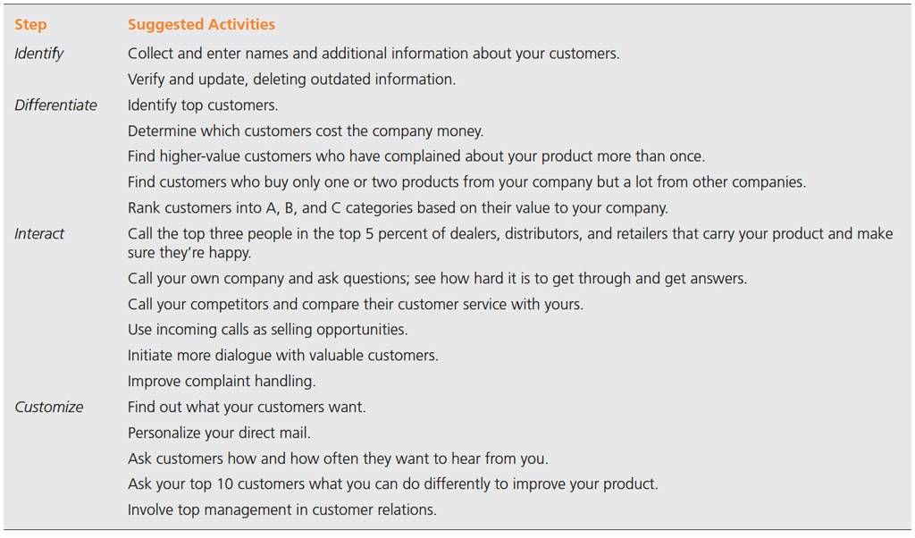
Table 6.2
The Four Steps of One-to-One Marketing
6-<number>
Notes:
This slide relates to LO #5 of chapter 6.
p. 209
LECTURE NOTES:
CRM facilitates one-to-one marketing, a process which is composed of four interrelated steps:
Step 1: Identify customers and get to know them in as much detail as possible.
Step 2: Differentiate customers by their needs and value to the company.
Step 3: Interact with customers; find ways to improve cost efficiency and the effectiveness of the interaction.
Step 4: Customize some aspect of the products you offer each customer.

Slide 51
CRM: A New Perspective on an Old Problem
CRM systems capture information
A touchpoint is a direct interface between customers and businesses
CRM systems include
    Order and delivery tracking websites
    Call centers
    Automatic reminder systems
    Sales contact management software
6-<number>
Notes:
This slide relates to LO #5 of chapter 6.
p. 208 - 209
LECTURE NOTES:
CRM systems use computers, software, databases, and the Internet to capture information at each touchpoint.
Touchpoints are any direct interface between customers and a company (online, by phone, in person, etc.)
Several examples of CRM systems are discussed in the textbook, including web sites that let you check the status of orders, pay or manage your bills online, track FedEx or UPS package deliveries, and even call center systems used by direct marketers who phone you at home or your place of business.
Automatic reminder systems that leave recorded messages about appointments, voting locations, utility outages, or upcoming sales at stores (such as Catherines’s clothing store) are also part of some organization’s CRM.
Sales contact management software makes it easy for B2B or B2C sales people to keep in contact with their client base on a variety of issues.
DISCUSSION NOTE:
Ask students to describe other examples of activities or contacts that they believe may stem from CRM systems. (Example: Banking – notifications of direct deposit, ability to transfer money between accounts or pay bills online, etc.)

Slide 52
Class Discussion
Describe other examples of activities or contacts that stem from CRM systems

Slide 53
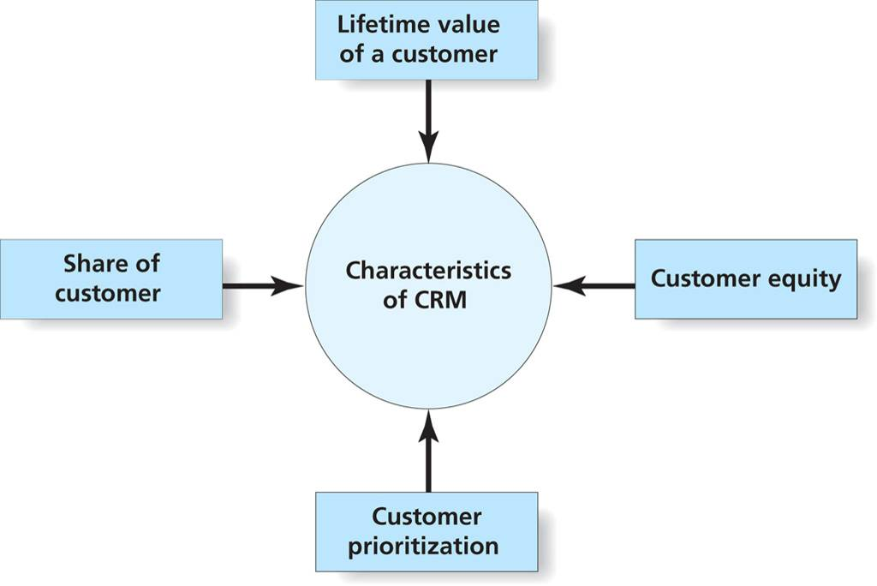
Figure 6.11
Characteristics of CRM
6-<number>
Notes:
LECTURE NOTES:
Firms that successfully make use of CRM have a different mind-set, different goals, different measures of success, and generally look at customers in a different way when compared to firms that don’t use CRM. Four critical characteristics of CRM are shown in Figure 6.11.
Share of customer: Unlike many businesses that focus on increasing a brand’s marketing share, firms that embrace CRM recognize that it is less costly to keep current customers happy then it is to get a new one to take their place. For this reason, CRM focuses on increasing a brand’s share of customer. Share of customer can be defined as the percentage of an individual customer’s purchase of a product (e.g., fast food) that belongs to a particular brand (e.g., Taco Bell). This is where CRM’s ability to customize and personalize marketing promotions to individual consumers can be helpful. For example, if Amazon’s database records indicate that a given patron has purchased three books by a certain author, the CRM aspect of this system would try to increase share of customer by automatically sending an email to that individual offering him or her the opportunity to preorder a new book which has been written by the author, but not yet released.
Lifetime value of the customer: Lifetime value is the potential profit a single customer’s purchase of a firm’s products generates over the customer’s lifetime. Estimating LVC requires that the firm first estimate future sales across all products for the next 20 or 30 years, and then that the firm attempt to figure out what profit the company could make from this customer in the future.
CRM firms view customers differently – as assets. Customer equity is defined as the financial (net) value of a customer throughout the lifetime of the relationship.
The final characteristic that makes CRM unique is the fact that organizations focus on high-value customers. This means the firm prioritizes its customers and customizes communications accordingly. For example, those who patronize casinos frequently will receive more direct mail offers from the casino, and higher value perks or incentives in an attempt to entice them to stay, compared to the that which would be sent to casual or infrequent gamblers. Remember that 80 /20 rule . . .in a CRM world, 80% of the profits often come from 20% of the customers.

Slide 54
Characteristics of CRM
Share of customer: The percentage of an individual customer’s purchase of a product (e.g., fast food) that belongs to a particular brand
CRM recognize that it is less costly to keep current customers happy then it is to get a new one to take their place

Slide 55
Characteristics of CRM
Lifetime value of the customer: The potential profit a single customer’s purchase of a firm’s products generates over the customer’s lifetime
CRM firms view customers differently – as assets

Slide 56
Characteristics of CRM
Customer equity: The financial (net) value of a customer throughout the lifetime of the relationship
Customer Prioritization: This characteristic makes CRM unique i.e the fact that organizations focus on high-value customers and customizes communications accordingly

Slide 57
All rights reserved. No part of this publication may be reproduced, stored in a retrieval system, or transmitted, in any form or by any means, electronic, mechanical, photocopying, recording, or otherwise, without the prior written permission of the publisher. Printed in Canada.
6-<number>

